Slide 1
EE-357: CCN Mobile Radio Propagation: Large Scale Path Loss
Hassaan Khaliq Qureshi
School of Electrical Engineering & Computer Science
National University of Sciences & Technology (NUST)
Pakistan

Slide 2
Credits and Acknowledgements
Throughout this course, I will be borrowing examples, explanations and figures from the following books:
Rappaport, Wireless Communications, Prentice Hall, 2002.
Wireless Communications and Networks by William Stallings.
I will also be borrowing examples and figures from the online course material provided by Prof. Andrea Goldsmith, Stanford University
In this particular lecture, I will be borrowing concepts and figures from the Advanced Communication Systems Course by Dr. Syed Ali Khayam who taught this course 2 years back.
I am also borrowing figures from Mike Willis’s online tutorial: http://www.mike-willis.com/Tutorial/PF7.htm

Slide 3
What will we cover in this lecture?
This lecture will cover some basic details on propagation and the largescale propagation effects that are commonly observed on a wireless communication system:
Modes of Propagation and some basic concepts
Free-Space Propagation
Isotropic and Directional Antennas
Terrestrial Propagation: Large Scale Physical Models
Reflection and Diffraction

Slide 4
Terrestrial Propagation: Large Scale Physical Models

Slide 5
Effective LOS
Line of sight (LoS) is a type of propagation that can transmit and receive data only where transmit and receive stations are in view of each other without any sort of an obstacle.
However, for Wireless Networks a modified line-of-sight transmission is used, which is made possible through a combination of effects like diffraction, multipath reflection, and rapid handoff. Therefore, receiver should be in an effective region covered by the Transmitter.

Slide 6
Terrestrial Propagation: Physical Models
In most wireless communication scenarios, terrestrial environment (buildings, terrain, vegetation, etc.) block line-of-sight communication
In this case, radio waves undergo three types of phenomena:
Reflection: caused by large objects; radio waves are reflected by the surface of the object
Diffraction: caused by sharp/irregular objects; radio waves bend around objects
Scattering: caused by small objects; radio waves are obstructed by the objects

Slide 7
Reflection
A wireless signal may reach the receiver from multiple paths due to reflections from nearby objects
This phenomenon is referred to as multipath propagation

Slide 8
Reflection
Multipath signals interfere with each other
This interference can be constructive or destructive depending on whether the multiple signals are synchronized or de-synchronized with each other
Constructive interference

Slide 9
Reflection
Multipath signals interfere with each other
This interference can be constructive or destructive depending on whether the multiple signals are synchronized or de-synchronized with each other
Destructive interference

Slide 10
Reflection: Plane-Earth Model
Due to the interference caused by multipath signals, the receive signal power of an antenna can be quite different from what is observed in the (ideal) free-space propagation model
As a first step, we only consider reflections from the earth’s surface.
Moreover, we assume a flat (or plane) earth surface and ignore the effect of the earth’s curvature on propagation
This model is valid for distances of less than tens of kilometers
This model is also called the two-ray or flat-earth propagation model
h_{T}
h_{R}
d

Slide 11
Reflection: Plane-Earth Model
We want to find the power at the receive antenna
Recall that the received power for a directional antenna is
So we essentially need to find the path loss L_{p} for the two-ray propagation environment
h_{T}
h_{R}
d

Slide 12
Reflection: Phase Difference
We need to find the path loss L_{p} for the two-ray propagation environment
We first find the difference in the distance traveled by both rays
Then we can use the following expression to find the phase difference of the received waves
Number of additional wavelengths travelled in distance ∆d
Conversion to radians
h_{T}
h_{R}
d

Slide 13
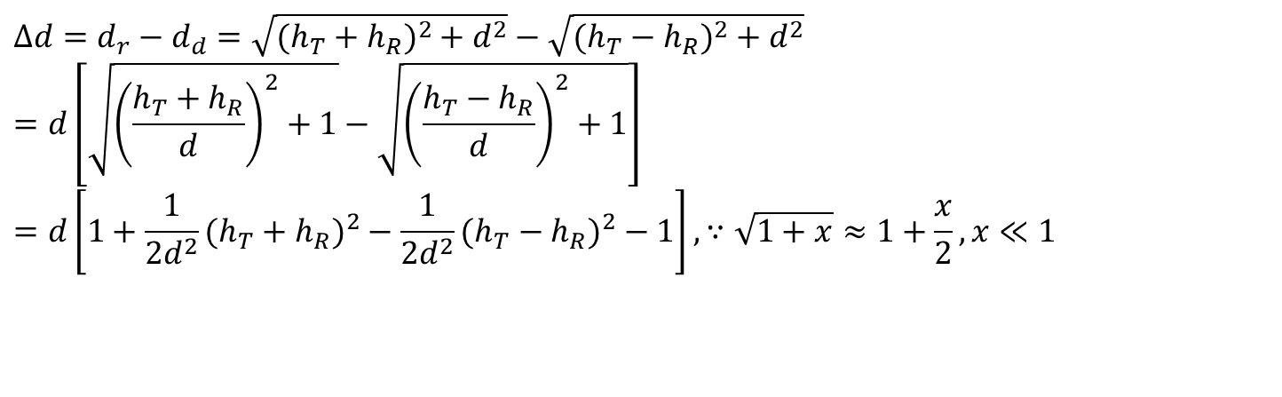
Reflection: Phase Difference
d_{d}
h_{T} -h_{R}
2h_{T}
d_{r}
h_{R}
h_{T} +h_{R}
d_{r}
d
$$Δd=d_{r}−d_{d}=\sqrt{(h_{T}+h_{R})^{2}+d^{2}}−\sqrt{(h_{T}−h_{R})^{2}+d^{2}} \\ =d\left[\sqrt{{\left(\frac{h_{T}+h_{R}}{d}\right)}^{2}+1}−\sqrt{{\left(\frac{h_{T}−h_{R}}{d}\right)}^{2}+1}\right] \\ =d\left[1+\frac{1}{2d^{2}}(h_{T}+h_{R})^{2}−\frac{1}{2d^{2}}(h_{T}−h_{R})^{2}−1\right],∵\sqrt{1+x}≈1+\frac{x}{2},x≪1$$
Notes:
it's just the binomial theorem and the binomial expansion. For small x, x^4 is much smaller than x^2 and can be neglected if an approximation is desired and same is applied above.

Slide 14

Reflection: Phase Difference
d_{d}
h_{T} -h_{R}
2h_{T}
d_{r}
h_{R}
h_{T} +h_{R}
d_{r}
d
$$Δd≈d\left[1+\frac{1}{2d^{2}}(h_{T}+h_{R})^{2}−\frac{1}{2d^{2}}(h_{T}−h_{R})^{2}−1\right] \\ Δd≈\frac{2h_{T}h_{R}}{d} \\ ⇒Δθ=2π\frac{Δd}{λ}≈\frac{4πh_{T}h_{R}}{λd}$$
Notes:
We know that the sinusoidal wave is represented by ASin(Wt +Phi or theta). We are interested in measuring the time delay or phase difference that is between this reflected wave and the direct wave.
Since Phi or theta is in radians, therefore the phase difference between the two paths is proportional to the transmission wavelength.

Slide 15
Example
h_{T} = 10m
h_{R} = 2m
d = 500m
Find the phase difference introduced by the above two-ray scenario when the carrier frequency is f_{c} = 900 MHz.

Slide 16
Reflection: Received Power
h_{T}
h_{R}
d
-1 for grazing earth distance
See Example 4.4 in Ref. book
Notes:
e^{jx} = cos x + j sin x also called hyperbolic functions.
Some of you might get confuse on how the power is related with electric field or electric field strength. Those are referred to read the article 4.3 of the reference book Rappaport.
Also read the web articles available on Complex Phasors. Phasors separate the dependencies on A, ω, and θ into three independent factors.
Why we take a magnitude:
Magnitude is total size of an effect. It usually means the absolute "size" of a quantity, ignoring other details like sign and direction.

Slide 17
Reflection: Phase Difference
h_{T}
h_{R}
d

Slide 18
Reflection: Phase Difference
h_{T}
h_{R}
d
Characteristic impedence of free space
Received power in free space from the direct path
Recall that the received power in free space is:
So the received power for the two ray model is:
Notes:
Electrical impedance is the measure current (AC) circuit. Impedance extends the concept of resistance to AC circuits, and possesses both magnitude and phase, unlike resistof the opposition that a circuit presents to the passage of a current when a voltage is applied. In quantitative terms, it is the complex ratio of the voltage to the current in an alternating ance, which has only magnitude.
The impedance of free space (used above in comparison to power flux density), ETA₀, is a physical constant relating the magnitudes of the electric and magnetic fields of electromagnetic radiation travelling through free space.

Slide 19


Reflection: Received Power
$$P_{R}≈P_{T}G_{T}G_{R}{\left(\frac{h_{T}h_{R}}{d^{2}}\right)}^{2}$$
Thus the path loss term for two-ray propagation is
$$L_{p}≈{\left(\frac{d^{2}}{h_{T}h_{R}}\right)}^{2}$$
h_{T}
h_{R}
d

Slide 20
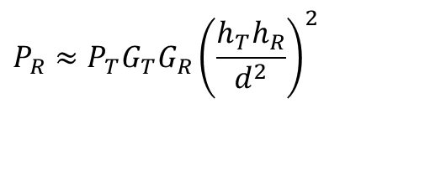
Reflection: Received Power
$$P_{R}≈P_{T}G_{T}G_{R}{\left(\frac{h_{T}h_{R}}{d^{2}}\right)}^{2}$$
Received power is a function of:
Antenna heights: Higher the antennas, greater the received power
Distance between the transmit and receive antennas: inverse fourth power decrease; attenuation is much faster than in free-space
Source: A. Goldsmith Book on Wireless Communications
Notes:
What is the effect of path loss on the performance of a cellular radio network. Is it good to have signals that attenuate rapidly with increasing distance?
The answer is Yes. Listen to the Audio Attachment on lms.
Why the fast attenuation in power is beneficial. Why don’t we reduce the transmitting power.
The first red line shows the transmit antenna height and demonstrates that what happens when distance increases than ht, the wave occurs multipath propagation up to critical distance (dc)[second red line]. After than there is a forth power decrease in the distance.
The transmitting power reduces the size of the cell and the area of particular coverage while on the other hand we have fixed number of frequencies , which we want to reuse over an over.

Slide 21
Exercise
h_{T}
h_{R}
d
A mobile is located 4 km away from a base station and uses a λ/2 monopole antenna with a gain of 2.55 dB to receive signals from the base station. The transmitter produces 50W of power and the carrier frequency is 900 MHz.
b) Find the received power at the mobile using the two ray model assuming base station antenna height of 40 m and mobile antenna height of 2.5m.

Slide 22
Exam Question [2021]
h_{T}
h_{R}
d
Consider a 10 Watt transmitter communicating with a mobile receiver having a sensitivity of -100 dBm (in watts it is equivalent to 10⁻¹³). Assume that the receiver antenna height is 2 m, and then transmitter and receiver antenna gains are 1 dB. What height of base station antenna would be necessary to provide a service area of radius 10 Km. If the receiver is mobile, and the maximum radiated power is restricted by regulation to be 10 watts or less, what realistic options are there for increasing the service area?

Slide 23
Exam Question
h_{T}
h_{R}
d
Answer:
The plane earth model indicates the base station antenna would have to be 4 meters in height. Service area may be increased either by improving receiver sensitivity, or boosting the transmitter antenna height, or increasing antenna gain. Realistically, a 4-meter antenna would be unlikely to provide a line of sight path over a distance of 10 km, thus the plane-earth model is applicable but service area would not be covered.

Slide 24
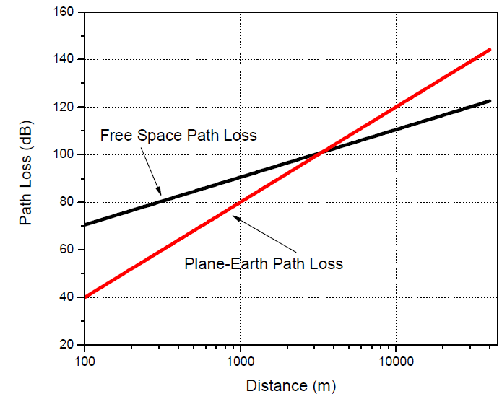
The Usability of Plane earth model
The plane-earth model applies only for R (or d) >> hR, hT. The plane-earth model shows less loss than free-space at distances less than a kilometer, Is this reasonable? How large should R be to apply the plane-Earth model?
Notes:
Earlier we supposed that given d is very large and wavelength is large compared to antennas heights, therefore sin(theta) can be taken as theta………This is why the model is applicable for only …………

Slide 25
Diffraction
Diffraction or shadowing is the bending of a radio wave around obstructions
This bending allows radio waves to reach locations when there is no line-of-sight.
While the signal strength decreases as one moves more and more towards the obstruction (shadow), there is still enough power in the diffracted signal that it can be decoded at the receiver.

Slide 26
Diffraction: Huygen’s Principle
Each point on a wave front acts as a point source for further propagation. However, the point source does not radiate equally in all directions but favors the forward direction of the wavefront.

Slide 27
Diffraction: Huygen’s Principle
Diffraction is caused by the propagation of secondary wavelets into a shadowed region.
Wavefront
Diffracted Wavefront
Knife Edge Obstruction

Slide 28
Diffraction: Phase Difference
We want to quantify the phase difference that the diffracted wave will experience
We know that the phase difference is given by:
where ∆d is the difference in distance between the direct and diffracted waves

Slide 29
Diffraction: Phase Difference
To compute ∆d, let us consider propagating from point T to R
An obstruction is blocking the LoS path
The obstruction has a circular radius, h
R
Q
h
O
d₂
T
d₁

Slide 30
Diffraction: Phase Difference
Any wave propagating through TQR is traveling more distance that TOR
R
Q
h
O
d₂
T
d₁

Slide 31
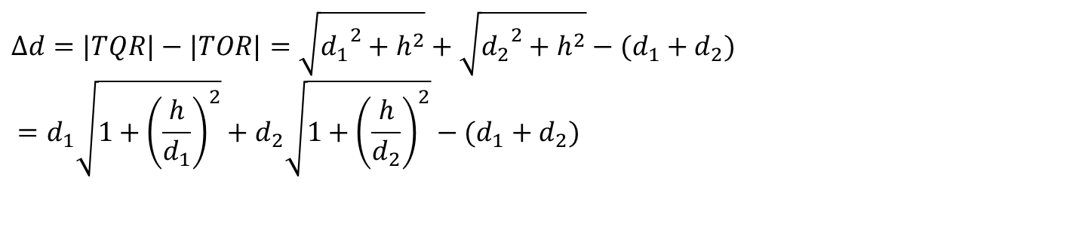
Diffraction: Phase Difference
$$Δd=|TQR|−|TOR|=\sqrt{{d_{1}}^{2}+h^{2}}+\sqrt{{d_{2}}^{2}+h^{2}}−(d_{1}+d_{2}) \\ =d_{1}\sqrt{1+{\left(\frac{h}{d_{1}}\right)}^{2}}+d_{2}\sqrt{1+{\left(\frac{h}{d_{2}}\right)}^{2}}−(d_{1}+d_{2})$$
R
Q
h
O
d₂
T
d₁

Slide 32
Diffraction: Phase Difference

Slide 33
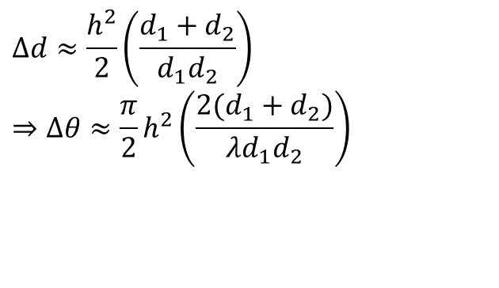

Diffraction: Phase Difference
$$Δd≈\frac{h^{2}}{2}\left(\frac{d_{1}+d_{2}}{d_{1}d_{2}}\right) \\ ⇒Δθ≈\frac{π}{2}h^{2}\left(\frac{2(d_{1}+d_{2})}{λd_{1}d_{2}}\right)$$
We define the Fresnel-Kirchhoff diffraction parameter as:
$$υ=h\sqrt{\frac{2(d_{1}+d_{2})}{λd_{1}d_{2}}} \\ ⇒Δθ≈\frac{π}{2}υ^{2}$$

